Slide 1
Chapter 12 Text IO

Slide 2
The File Class
The File class is intended to provide an abstraction that deals with most of the machine-dependent complexities of files and path names in a machine-independent fashion. The filename is a string. The File class is a wrapper class for the file name and its directory path.

Slide 3
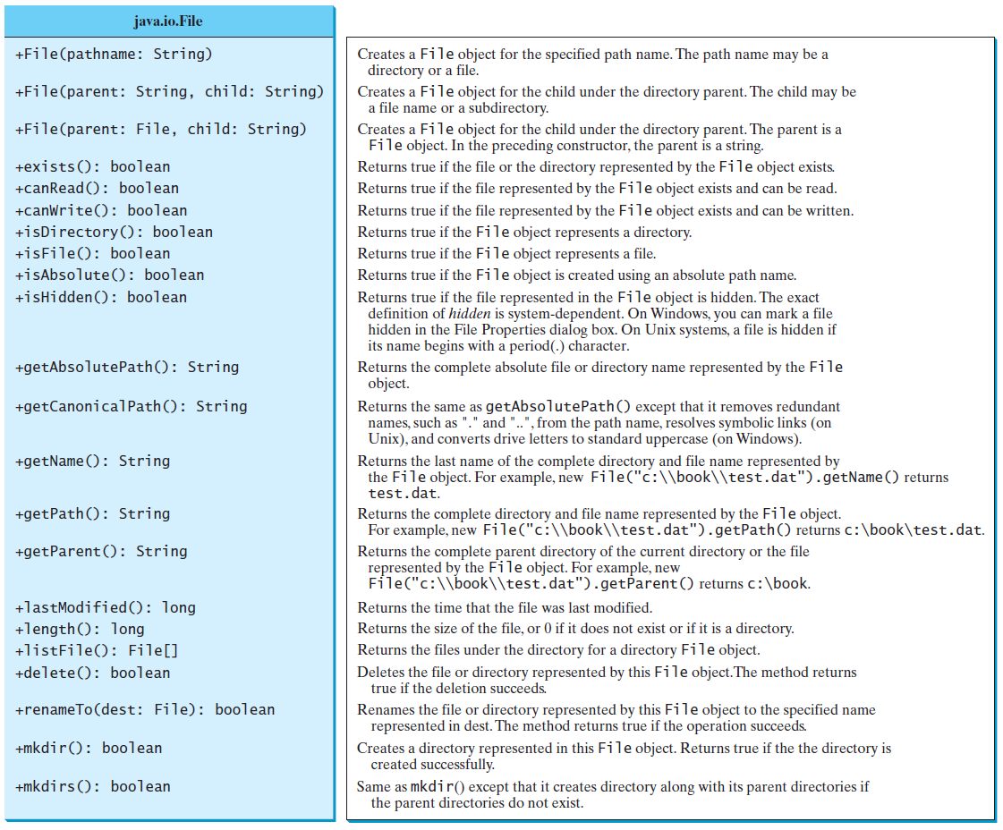
Obtaining file properties and manipulating file

Slide 4
Text I/O
A File object encapsulates the properties of a file or a path, but does not contain the methods for reading/writing data from/to a file. In order to perform I/O, you need to create objects using appropriate Java I/O classes. The objects contain the methods for reading/writing data from/to a file. This section introduces how to read/write strings and numeric values from/to a text file using the Scanner and PrintWriter classes.

Slide 5
Writing Data Using PrintWriter

Slide 6
Try-with-resources
Programmers often forget to close the file. JDK 7 provides the followings new try-with-resources syntax that automatically closes the files.
try (declare and create resources) {
Use the resource to process the file;
}
WriteDataWithAutoClose
Run

Slide 7
Reading Data Using Scanner
ReadData
Run

Slide 8
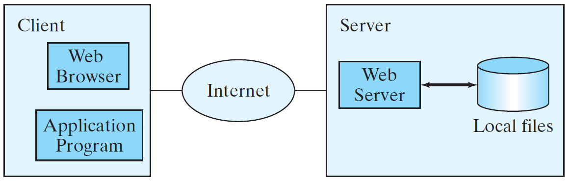
Reading Data from the Web
Just like you can read data from a file on your computer, you can read data from a file on the Web.

Slide 9
Reading Data from the Web
URL url = new URL("www.google.com/index.html");
After a URL object is created, you can use the openStream() method defined in the URL class to open an input stream and use this stream to create a Scanner object as follows:
Scanner input = new Scanner(url.openStream());

